Slide 1
Mapping the Cosmos
A Card Game (2-4 players)
Introduction
Astronomers survey the sky for many different reasons. This could be to do science with large samples of objects or to look for rare things to study with more observations. The Sloan Digital Sky Survey (SDSS) takes spectra of stars, galaxies and massive black holes known as quasars. A spectrum is the light of an astronomical object split up into all its different colors. SDSS observes hundreds of objects at the same time. This is done by feeding the light from a telescope to a special instrument where hundreds of tiny robots that position fiberoptic cables. They position these cables to match the position of a star, galaxy or quasar. Each of these cables leads to an instrument know as a spectrograph for measuring the spectrum of that object.
Different astronomers study different types of objects. They often collaborate together on projects where lots of different astronomers with different interests work together so they can all get their observations done to pursue their own science goals. But surveys also have a legacy value. If you make lots of observations of the sky public then other astronomers can use those observations for their own science goals and give you the credit for taking the observations.
Astronomy isn’t always the easiest science. You have to contend with poor weather or instrument problems. You also have to deal with moonlight. When the moon is in the sky and close to being a full moon it floods the sky with lots of blue light. This is called bright time when it is harder to observe and when the its especially hard to observe blue targets. Conversely when the moon is not in the sky it is dark time, when observing is easier.
Sometimes astronomers can get lucky and have the chance to observe exploding stars known as supernovae or explosions on white dwarfs known as novae. Very occasionally they might get the chance to look for the light from a gravitational wave event where colliding black holes have been detected by a gravitational wave observatory. Collectively these chance observations are called Targets of Opportunity (ToO).
The game isn’t exactly like how astronomers in the Sloan Digital Sky Survey operate. It has dedicated telescopes so can observe all night, can observe different typers of target at the same time & its observatory directors aren’t decks of cards. But it does show how astronomers need to balance the needs of lots of scientists when doing a survey of the sky.

Slide 2
Setup
Gameplay
Firstly, remove the legacy survey card from the science goals deck and place it face up. Shuffle the rest of the cards in the science goals deck.
There are two ways to set up, quick play if you want to start quickly and normal play.
Quick play: for each player put one randomly selected 1 hour card, 2 two hour cards and one each of 3,4,5 and 6 hour cards in a deck and shuffle. Remove the extra observatory cards (those marked with an *) and put all the other event cards in a deck and shuffle.
Normal play: Start by building the time and event decks. Split the time deck into six piles of 1, 2, 3, 4, 5 and 6 hour cards, shuffle each. Split the event deck into weather, observatory and ToO cards, shuffle each. Remove all the extra observatory cards (those marked with an *) and don’t use them in the game.
Time deck: add two one hour time cards per player and two two hour time cards per player to the time deck, shuffle the deck.
Event deck: for each player add one randomly selected weather card, two randomly selected observatory card and three randomly selected ToO cards. Shuffle the deck.
Before the start of turns 2-6 you will add more cards to the decks.
Before turn 2: add two two hour time card per player to the time deck and add one randomly selected weather card per player to the event deck, shuffle both decks.
Before turn 3: add two three hour time card per player to the time deck and add one randomly selected weather card per player to the event deck, shuffle both decks.
Before turn 4: add two four hour time card per player to the time deck and add one randomly selected weather card per player to the event deck, shuffle both decks.
Before turn 5: add two five hour time card per player to the time deck and add one randomly selected weather card per player to the event deck, shuffle both decks.
Before turn 6: add two six hour time card per player to the time deck and add one randomly selected weather card per player to the event deck, shuffle both decks.
In this game each player takes the role of an astronomer carrying out a survey of objects in the sky. At the start of the game, you will each draw one science goal card. This will say what your science goal is. Keep this card until the end of the game.
Each turn (which represents a month) each player will be given observing time on three nights by the observatory director (three cards from the time deck). Place these three cards in a row in-front of you. Next, each player will also draw one event card. This could be bad weather, an interesting Target of Opportunity (ToO) or something happening at the observatory.
Each player can then spend the time from each night to observe one type of object. There are four types of objects in the game: white dwarfs, nearby quasars, distant quasars and red giants. Each have slightly different observational properties. A player may only use the time on one time card for one type of object with the exception of Targets of Opportunity.
Any player who draws a Targets of Opportunity (ToO) card can observe it by using part of the time on one night. So, for example a player with a ToO that needs one hour to observe and a two hour time card can spend one hour from this card to observe the ToO and can use the rest of the time on that card to observe one other type of object. At the end of each turn keep any target of opportunity cards you observed, discard any unobserved ToO cards.
At the end of every turn return all of the used time cards to the time deck. Discard all used event cards except observed Target of Opportunity cards. Shuffle both decks.
The game lasts for 6 turns, with each turn representing a month. In quick play each month is equal. In normal play the game starts in the summer when the nights are short but the weather is good. As the turns progress the nights get longer but the weather gets worse.
At the end of the game the legacy survey prize will be awarded to the player with the best legacy survey. You will need to observe the widest range of objects you can to win this prize.

Slide 3
Using Observing Time
White Dwarfs
blue and faint
Nearby Quasars
blue and bright
500 objects per hour of dark time
200 objects per hour of bright time
Score 1 point per 400 white dwarfs
1000 objects per hour of dark time
400 objects per hour of bright time
Score 1 point per 800 nearby quasars
Distant Quasars
red and faint
Red Giants
Red and bright
500 objects per hour of dark time
400 objects per hour of bright time
Score 1 point per 500 distant quasars
1000 objects per hour of dark time
800 objects per hour of bright time
Score 1 point per 1000 red giants
Legacy Survey Prize
Awarded to the player who has the widest range of objects observed after 6 turns. Look at the four types of objects. The lowest number of the four types of object is your legacy survey score. The player with the highest legacy survey score wins the legacy survey prize and the points it brings.
Example: Two players have collected the following number of objects. The lowest number of the 4 types of object player 1 has is 4000, that is his legacy survey score. The lowest number of objects player 2 has is 5000, that is her legacy survey score. In this situation player 2 wins the legacy survey bonus card and the 20 points it brings.
 | White dwarfs | Nearby Quasars | Distant Quasars | Red Giants
Player 1 | 4000 | 8000 | 6000 | 10000
Player 2 | 6000 | 7000 | 5000 | 7000

Slide 4


An Example Turn
Variants to Try
Player 1 draws the following time and event cards
If you’ve played the game a few times then why not try one of these variants to make things a bit different.
Extra Observatory Cards: Use the extra observatory cards (those marked with an *) in the game
Trading Time: Each turn, once all players have drawn all time and event cards, players can trade time by bartering with other players. If a player trades time on a night affected by a weather card, the effect of that weather card is applied to the time before it is traded
More Science Goals: Allow players who have completed their science goal to draw a new science goal. If a player draws a new science goal and then doesn’t complete it then subtract the points on the card for that science goal from that player’s total at the end.
Target of Opportunity Priority: ToOs are very important so you should be able to take control of the telescope to observe one. In this variant if you draw a ToO card, you may use it to take the exact amount of time listed on the card from another player. You use that amount of time from the other player to observe your ToO and they cannot use that time. All players will need to draw time and event cards for a turn/month at the same time to make this work.
The full year: Play a longer version of the game in normal play by adding an extra six months. When doing this double the number of objects needed to complete each science goal and double the points for all science goals. The first six turns operate the same as the normal play rules with one exception, so not discard your event cards (with the exception of ToO cards) and shuffle them back in to the deck. At the start of turn 7, two new ToO cards per player are added to the deck. After turn 7 remove cards from the time and event deck in the…
Patchy Cloud
Lose 50% of time on middle night
2 hour
dark time
2 hours
bright time
1 hour
dark time
Player 1 uses his 2 hours on the first night to observe white dwarfs. He has lost half of his time on the middle night to cloud so uses the remaining hour to observe red giants and then also uses the 1 hour on the last night to observe white dwarfs. He notes down 1500 white dwarfs and 800 red giants in the row for this turn on his scorecard.
Player 2 draws the following time and event cards
Supernova
Spend 1 hour bright or dark time
2 points
2 hour
dark time
1 hour
dark time
2 hours
bright time
Player 2 uses her 2 hours on the first night to observe nearby quasars. She use the 1 hour on the middle night to observe white dwarfs. Finally she uses one hour of the time on the last night to observe her Target of Opportunity (ToO) supernova and the remaining one hour on the last night of time to observe distant quasars. As player 2 observed her ToO card she keeps it until the end of the game. She notes down 500 white dwarfs, 2000 nearby quasars and 400 distant quasars in the row for this turn on her scorecard.

Slide 5
Variants to Try (cont.)
SDSS is managed by the Astrophysical Research Consortium for the Participating Institutions of the SDSS Collaboration, including Caltech, the Carnegie Institution for Science, Chilean National Time Allocation Committee (CNTAC) ratified researchers, The Flatiron Institute, the Gotham Participation Group, Harvard University, Heidelberg University, The Johns Hopkins University, L’Ecole polytechnique fédérale de Lausanne (EPFL), Leibniz-Institut für Astrophysik Potsdam (AIP), Max-Planck-Institut für Astronomie (MPIA Heidelberg), Max-Planck-Institut für Extraterrestrische Physik (MPE), Nanjing University, National Astronomical Observatories of China (NAOC), New Mexico State University, The Ohio State University, Pennsylvania State University, Smithsonian Astrophysical Observatory, Space Telescope Science Institute (STScI), the Stellar Astrophysics Participation Group, Universidad Nacional Autónoma de México, University of Arizona, University of Colorado Boulder, University of Illinois at Urbana-Champaign, University of Toronto, University of Utah, University of Virginia, Yale University, and Yunnan University.
reverse order you added them in the first 6 months. So, at the start of turn 8 remove the 6 hour cards from the time deck and one weather card per player from the event deck. Then remove all the 5 hour cards and one weather card per player at the start of turn 9, etc. Use a second scorecard for the second six months. All observations across the twelve months towards science goalsß.
Credits
Game: Sloan Digital Sky Survey/Niall Deacon
Image credits: Sloan Digital Sky Survey
Illustration images: Time – IC 5146; Event – NGC 5257; Science Goals – Stephan’s Quintet, Box image – Abell 2151
Icon credits: Font Awesome by Dave Gandy - fontawesome.io
Thanks to the Anne-Marie Weijmans, the St Andrews galaxies group, Emily Griffith & the group at the University of Colorado, and the Haus der Astronomie BOGY interns for helping to test the game and for giving helpful feedback and suggestions for new rules.
Published under a Creative Commons CC-BY-4.0 License
Funding for the Sloan Digital Sky Survey V has been provided by the Alfred P. Sloan Foundation, the Heising-Simons Foundation, the National Science Foundation, and the Participating Institutions. SDSS acknowledges support and resources from the Center for High-Performance Computing at the University of Utah. SDSS telescopes are located at Apache Point Observatory, funded by the Astrophysical Research Consortium and operated by New Mexico State University, and at Las Campanas Observatory, operated by the Carnegie Institution for Science. The SDSS web site is www.sdss.org.

Slide 7
Teacher Notes
This game presents a very simplified version of some of the trade-offs astronomers need to make when conducting surveys.
Some things your students may learn playing this game:
Notes on types of objects:
White dwarfs are the remnants of stars that have reached the end of their hydrogen burning lives and then evolved first to giant stars and then to planetary nebulae. In the planetary nebula phase the dying star throws off its outer layers, leaving only the remaining hot dense core. This hot dense core is the white dwarf. White dwarfs cool over time at a predictable rate so can be used as probes of the history of our galaxy.
Red giants are old stars that have finished burning hydrogen in their cores but haven’t yet reached the point of evolving in to white dwarfs. They are bright and the different lines in their spectra can be used to estimate the abundances of different elements.
Nearby and distant quasars are both types of quasars. Gas and dust falling towards supermassive black holes at the heart of distant galaxies can form a disk of material orbiting the black hole. The huge gravitational pull of these black holes can lead to these disks rotating extremely fast and the material in them becoming very hot. These huge hot disks of material are extremely bright and can outshine all of the stars in the surrounding galaxy a thousand times over. Quasars’ spectra are redshifted, the more distant they are the more they are redshifted. This moves some of their bright emission features from ultraviolet light, to visible light, or for the most distant quasars, to the infrared. This changes the colours of the quasars, making more distant quasars appear redder.
Poor weather can affect astronomical observations
Sometimes astronomical instruments have problems that may affect observations (the game exaggerates how often and severe these are).
Much of science is done by large groups of scientists with different interests who work together
Moonlight can affect astronomical observations, particularly when looking in blue light
Luck can also be a factor
Astronomers need to take lots of things into account when planning efficient observations
Some notes on specific cards: the red monster was a nickname given to an instrument problem that occasionally would affect the redder part of the spectrum. It made the spectra less accurate but didn’t stop the observation of red objects. A bear did once get into the kitchen at the Apache Point Observatory, nobody was harmed by the bear. Moths do sometimes get into our spectrographs as they are nice, warm places. Other observatories sometimes have surprise visitors like scorpions. Bonsai is the dog of one of the staff at Apache Point, he’s very friendly to visitors.

Slide 8
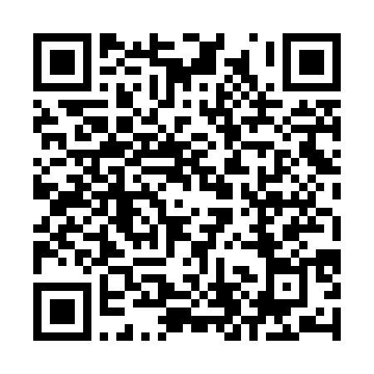
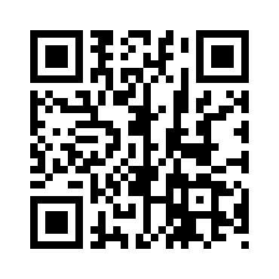
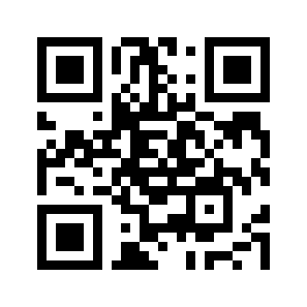
Teacher Notes (cont.)
Notes on observing time:
Astronomers typically try to observe objects so that they get a good ratio of signal to noise. If the signal to noise ratio of an observation of an object is too low then noise could make measurements of the properties of that object too inaccurate to use. Normally the longer you observe for, the better your signal to noise ratio. But at some point once an object has been observed for long enough, the signal to noise ratio is high enough for the purposes the astronomer wants to use the observation for so it would be a waste of time to observe for longer.
The fainter the object, the longer you would need to observe to get the required signal to noise ratio.
The brightness of an astronomical object is a combination of the object’s intrinsic brightness and how far away that object is.
The game over-simplifies brightness into objects being either bright or faint
The moon affects observations. When the moon is close to full and in the sky it emits a lot of blue light. This means that if you are trying to study objects where their properties in blue light is important, the observations will be made worse by the moon being in the sky. Hence astronomers prefer to observe faint, bluer objects in ”dark time” when the moon is not in the sky as opposed to “bright time” when it is.
Here are several ways you could use this game in a wider lesson:
Ask your students to research the different types of objects used in this game and why astronomers study their spectra.
Ask the students about the usage of observing time. Why do they think fewer faint objects are observed per hour?
Discuss with students how they would decide on how to allocate telescope resources. See if your students get something like the common model of writing proposals for observations and then a committee evaluating these proposals or if they have a different idea.
Give students or groups of students one science goal card each and ask them to come up with arguments as to why this science goal is important. This will involve background research.
Download and print copies of this game
More SDSS
educational activities
From SDSS
From Zenodo
record: 15526772
voyages.sdss.org

Slide 9
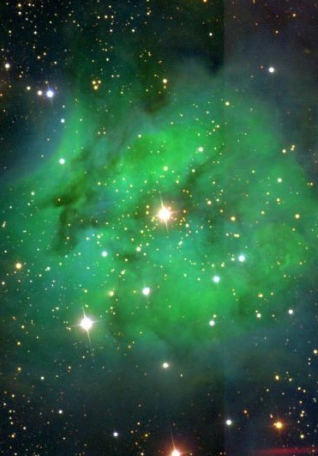

Time
Time
Time
Time
Time
Time
Time
Time

Slide 10
çç
1 hour
Dark Time
1 hour
Dark Time
1 hour
Dark Time
1 hour
Dark Time
1 hour
Dark Time
1 hour
Dark Time
1 hour
Bright Time
1 hour
Bright Time

Slide 11
Time
Time
Time
Time
Time
Time
Time
Time

Slide 12
2 hours
Dark Time
2 hours
Dark Time
2 hours
Dark Time
2 hours
Dark Time
2 hours
Dark Time
2 hours
Dark Time
2 hours
Dark Time
2 hours
Dark Time

Slide 13
Time
Time
Time
Time
Time
Time
Time
Time

Slide 14
2 hours
Bright Time
2 hours
Bright Time
2 hours
Bright Time
2 hours
Bright Time
2 hours
Bright Time
2 hours
Bright Time
2 hours
Dark Time
2 hours
Dark Time

Slide 15
Time
Time
Time
Time
Time
Time
Time
Time

Slide 16
3 hours
Dark Time
3 hours
Dark Time
3 hours
Bright Time
3 hours
Bright Time
4 hours
Dark Time
4 hours
Dark Time
4 hours
Bright Time
4 hours
Bright Time

Slide 17
Time
Time
Time
Time
Time
Time
Time
Time

Slide 18
3 hours
Dark time
3 hours
Dark time
3 hours
Dark time
3 hours
Dark time
4 hours
Dark time
4 hours
Dark time
4 hours
Dark time
4 hours
Bright time

Slide 19
Time
Time
Time
Time
Time
Time
Time
Time

Slide 20
5 hours
Dark Time
5 hours
Dark Time
5 hours
Bright Time
5 hours
Bright Time
6 hours
Dark Time
6 hours
Dark Time
6 hours
Bright Time
6 hours
Bright Time

Slide 21
Time
Time
Time
Time
Time
Time
Time
Time

Slide 22
5 hours
Dark Time
5 hours
Dark Time
5 hours
Dark Time
5 hours
Dark Time
6 hours
Dark Time
6 hours
Dark Time
6 hours
Dark Time
6 hours
Bright Time

Slide 23
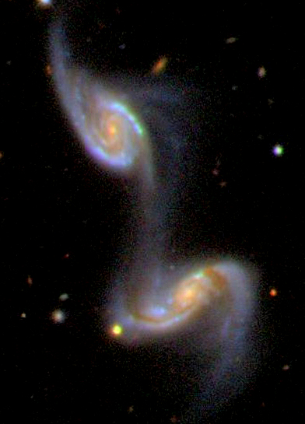

Event
Event
Event
Event
Event
Event
Event
Event

Slide 24
ToO
ToO
ToO
ToO
Supernova
Spend 1 hour of bright or dark time to receive
2 points
If you observe this card keep it until the end of the game. Otherwise discard it
Supernova
Spend 1 hour of bright or dark time to receive
2 points
If you observe this card keep it until the end of the game. Otherwise discard it
Supernova
Spend 1 hour of bright or dark time to receive
2 points
If you observe this card keep it until the end of the game. Otherwise discard it
Supernova
Spend 1 hour of bright or dark time to receive
2 points
If you observe this card keep it until the end of the game. Otherwise discard it
ToO
ToO
ToO
ToO
Supernova
Spend 1 hour of bright or dark time to receive
2 points
If you observe this card keep it until the end of the game. Otherwise discard it
Supernova
Spend 1 hour of bright or dark time to receive
2 points
If you observe this card keep it until the end of the game. Otherwise discard it
Supernova
Spend 1 hour of bright or dark time to receive
2 points
If you observe this card keep it until the end of the game. Otherwise discard it
Supernova
Spend 1 hour of bright or dark time to receive
2 points
If you observe this card keep it until the end of the game. Otherwise discard it

Slide 25
Event
Event
Event
Event
Event
Event
Event
Event

Slide 26
ToO
ToO
ToO
ToO
Peculiar Supernova
Spend 2 hour of bright or dark time to receive
4 points
If you observe this card keep it until the end of the game. Otherwise discard it
Peculiar Supernova
Spend 2 hour of bright or dark time to receive
4 points
If you observe this card keep it until the end of the game. Otherwise discard it
Peculiar Supernova
Spend 2 hour of bright or dark time to receive
4 points
If you observe this card keep it until the end of the game. Otherwise discard it
Peculiar Supernova
Spend 2 hour of bright or dark time to receive
4 points
If you observe this card keep it until the end of the game. Otherwise discard it
ToO
ToO
ToO
ToO
Galactic Nova
Spend 2 hour of bright or dark time to receive
5 points
If you observe this card keep it until the end of the game. Otherwise discard it
Galactic Nova
Spend 2 hour of bright or dark time to receive
5 points
If you observe this card keep it until the end of the game. Otherwise discard it
Galactic Nova
Spend 2 hour of bright or dark time to receive
5 points
If you observe this card keep it until the end of the game. Otherwise discard it
Gravitational Wave Event
Spend 3 hours of dark time to receive
15 points
If you observe this card keep it until the end of the game. Otherwise discard it

Slide 27
Event
Event
Event
Event
Event
Event
Event
Event

Slide 28
Observatory
Observatory
Observatory
Observatory
Great Conditions
An unusually calm atmosphere and clear skies mean that your observations are even more efficient than usual. Add 20% to all the numbers of objects you observe this month. Round up to the nearest hundred for each type of object.
Robot Error
Some of the robots that position the fibers on your spectrograph have failed. Lose 1/3 of the objects you observe on all nights this month (round your remaining objects up to the nearest 100 objects)
Observatory Dog
Bonsai, the observatory dog, comes to visit. This doesn’t change your observations, but you feel better petting the good boy.
Observatory Dog
Bonsai, the observatory dog, comes to visit. This doesn’t change your observations, but you feel better petting the good boy.
Observatory
Observatory
Observatory
Observatory
BEAR!!!!!
A hungry bear is ransacking the observatory kitchen, evacuate now! Lose all of your observing time on the middle night
Red Monster
A strange instrument error known as the red monster has affected your red spectrograph. You may not observe red objects on the right-most night.
Moth Infestation
Your blue spectrograph is infested with moths. You may not observe any blue objects on the left-most night
Observatory Dog
Bonsai, the observatory dog, comes to visit. This doesn’t change your observations, but you feel better petting the good boy.

Slide 29
Event
Event
Event
Event
Event
Event
Event
Event

Slide 30
Weather
Weather
Weather
Weather
Thick Cloud
Thick Cloud
Thick Cloud
Thick Cloud
Lose all of your observing time on the left-most night
Lose all of your observing time on the left-most night
Lose all of your observing time on the right-most night
Lose all of your observing time on the right-most night
Weather
Weather
Weather
Weather
Thick Cloud
Thick Cloud
Constant Cloud
Constant Cloud
Lose all of your observing time on the middle night
Lose all of your observing time on the middle night
Lose all of your observing time this month
Lose all of your observing time this month

Slide 31
Event
Event
Event
Event
Event
Event
Event
Event

Slide 32
Weather
Weather
Weather
Weather
Patchy Cloud
Patchy Cloud
Patchy Cloud
Patchy Cloud
Lose 50% of your observing time on the left-most night (round your remaining observing time up to the nearest hour)
Lose 50% of your observing time on the left-most night (round your remaining observing time up to the nearest hour)
Lose 50% of your observing time on the left-most night (round your remaining observing time up to the nearest hour)
Lose 50% of your observing time on the left-most night (round your remaining observing time up to the nearest hour)
Weather
Weather
Weather
Weather
Patchy Cloud
Patchy Cloud
Patchy Cloud
Patchy Cloud
Lose 50% of your observing time on the middle night (round your remaining observing time up to the nearest hour)
Lose 50% of your observing time on the middle night (round your remaining observing time up to the nearest hour)
Lose 50% of your observing time on the middle night (round your remaining observing time up to the nearest hour)
Lose 50% of your observing time on the middle night (round your remaining observing time up to the nearest hour)

Slide 33
Event
Event
Event
Event
Event
Event
Event
Event

Slide 34
Weather
Weather
Weather
Weather
Patchy Cloud
Patchy Cloud
Patchy Cloud
Patchy Cloud
Lose 50% of your observing time on the left-most night (round your remaining observing time up to the nearest hour)
Lose 50% of your observing time on the left-most night (round your remaining observing time up to the nearest hour)
Lose 50% of your observing time on the left-most night (round your remaining observing time up to the nearest hour)
Lose 50% of your observing time on the left-most night (round your remaining observing time up to the nearest hour)
Weather
Weather
Weather
Weather
Patchy Cloud
Patchy Cloud
Patchy Cloud
Patchy Cloud
Lose 50% of your observing time on the left-most night (round your remaining observing time up to the nearest hour)
Lose 50% of your observing time on the middle night (round your remaining observing time up to the nearest hour)
Lose 50% of your observing time on the middle night (round your remaining observing time up to the nearest hour)
Lose 50% of your observing time on the middle night (round your remaining observing time up to the nearest hour)

Slide 35

Event
Event
Event
Event

Slide 36
Observatory*
Observatory*
White Dwarfs
faint and blue
The glowing remnants of dead stars can be used to trace the history of our galaxy.
Observing
1 hour dark time → 500
1 hour bright time → 200
Scoring
1 point per 400
Nearby Quasars
bright and blue
The huge churning disks of hot gas orbiting black holes are the brightest objects in the universe.
Observing
1 hour dark time → 1000
1 hour bright time → 400
Scoring
1 point per 800
Snow Storm
Hard Drive Error
A huge snow storm is approaching the observatory, everyone must evacuate. All players lose all their time from all of their nights this month.
The hard drive you stored some of your data on has crashed. Lose 50% of the objects you observed in the previous month. If you draw this in month number one ignore this card
Observatory*
Observatory*
Distant Quasars
faint and red
The hot disks around black holes shine like beacons in the furthest reaches of the cosmos.
Observing
1 hour dark time → 500
1 hour bright time → 400
Scoring
1 point per 500
Red Giants
bright and red
These bright stars at the end of their lives can be used to map the structure and chemical history of the galaxy.
Observing
1 hour dark time → 1000
1 hour bright time → 800
Scoring
1 point per 1000
Classification Error
Great Conditions
An unusually calm atmosphere and clear skies mean that your observations are even more efficient than usual. Add 20% to all the numbers of objects you observe this month. Round up to the nearest hundred for each type of object.
The algorithm you used to select objects in the previous month had an error in it and you observed the wrong types of object. Switch the numbers of objects you observed last month as follows
If you draw this in month number one ignore this card
white dwarfs → nearby quasars
nearby quasars → white dwarfs
distant quasars → red giants
red giants → distant quasars

Slide 37
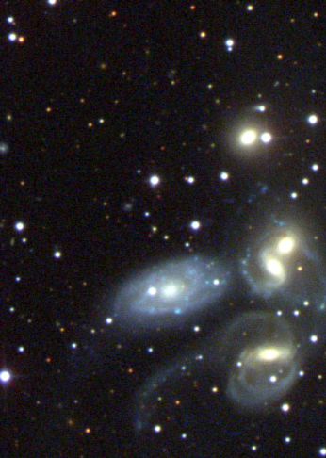

Science Goal
Science Goal
Science Goal
Science Goal
Science Goal
Science Goal
Science Goal
Science Goal

Slide 38
Cosmological Mapper
Observe at least 10,000 nearby quasars and at least 5,000 distant quasars
15 points
Nearby Universe Mapper
Observe at least 15,000 nearby quasars
10 points
Distant Universe Mapper
Observe at least 9,000 distant quasars
10 points
Quick Reactions
Observe at least 2 targets of opportunity
10 points
All
Galactic Mapper
Observe at least 10,000 red giants and 5,000 white dwarfs
15 points
Galactic Archeologist
Observe at least 7,500 white dwarfs
10 points
Galactic Structure Mapper
Observe at least 18,000 red giants
10 points
Legacy Survey
Observe the broadest range of objects.
20 points

